Slide 1

Task 1
Web scraping to gain company insights

Slide 2
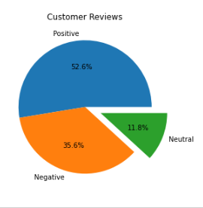
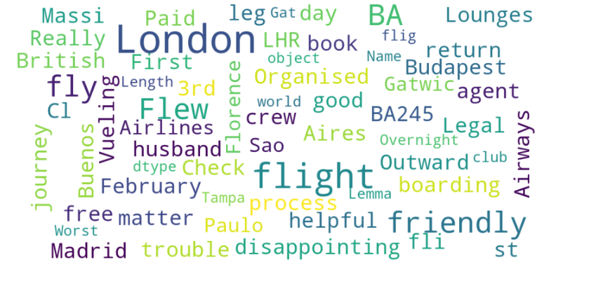
Insights of Customers Review
From cleaning 1000 reviews given by the customers, we obtained
Positive Reviews – 526(52.6%)
Negative Reviews – 356(35.6%)
Neutral Reviews – 118(11.8%)
Bar Plot for Customers Reviews
WordCloud to visualize most frequent words

